Slide 1
Introduction
1.Introduction
1.1 History of UNIX
UNIX is an Operating System (OS).
UNIX was developed about 40 years ago i.e., 1969 at T& Bell Labs by Ken Thompson and Dennis Ritchie.
It is a Command Line Interpreter.
It was developed for the Mini-Computers as a time sharing system.
UNIX was the predecessor of LINUX.
1.2 History of LINUX
LINUX was created by Linus Torvalds in 1991.
LINUX is a open source.
LINUX is a variant of UNIX.
1

Slide 2
Introduction
1.3 Why LINUX/UNIX?
LINUX is free.
Can view and edit the source code of OS
It is fully customizable.
Most Important Feature is Stability
Important in shared environments and critical applications
LINUX has better security structure.
High Portability
Easy to port new H/W Platform
Written in C which is highly portable
2

Slide 3
File Handling Utilities
File handling Utilities can be classified in to following categories They are ,
File creating and deleting
File naming or renaming
Editing files
File access permissions
1) File creating and deleting
Commands for creating and deleting the files are cat and rm respectively.
Creating: $ cat > file1
Enter your text
Ctrl+d
The file1 has been created
3

Slide 4
Commands
Deleting: rm COMMAND:
rm linux command is used to remove/delete the file from the directory.
SYNTAX: $rm [options..] [file | directory]
OPTIONS:
-f Remove all files in a directory without prompting the user.
-i Interactive. With this option, rm prompts for confirmation before removing any files.
-r (or) –R Recursively remove directories and subdirectories in the argument list. The directory will be emptied of files and removed. The user is normally prompted for removal of any write-protected files which the directory contains.
Ex:
$ rm file1
The file1 has been deleted
4

Slide 5
Commands
EXAMPLE: 1) To Remove / Delete a file:
rm file1.txt
Here rm command will remove/delete the file file1.txt.
2. To delete a directory tree:
rm -ir tmp
This rm command recursively removes the contents of all subdirectories of the tmp directory, prompting you regarding the removal of each file, and then removes the tmp directory itself.
3. To remove more files at once
rm file1.txt file2.txt
rm command removes file1.txt and file2.txt files at the same time.
5

Slide 6
Commands
2) File naming or renaming: Unix support following command for renaming the file as,
$ mv [options] file1 newfile
file1 renamed as newfile
mv command which is short for move. It is used to move/rename file from one directory to another. mv command is different from cp command as it completely removes the file from the source and moves to the directory specified, where cp command just copies the content from one file to another.
OPTIONS:
-f This will not prompt before overwriting (equivalent to --reply=yes). mv -f will move the file(s) without prompting even if it is writing over an existing target.
-i Prompts before overwriting another file.
6

Slide 7
Commands
EXAMPLE:
To Rename / Move a file:
mv file1.txt file2.txt
This command renames file1.txt as file2.txt
2. To move a directory
mv hscripts tmp
In the above line mv command moves all the files, directories and sub-directories from hscripts folder/directory to tmp directory if the tmp directory already exists. If there is no tmp directory it rename's the hscripts directory as tmp directory.
3. To Move multiple files/More files into another directory
mv file1.txt tmp/file2.txt newdir
This command moves the files file1.txt from the current directory and file2.txt from the tmp folder/directory to newdir.
7

Slide 8
File Handling Utilities
3) Editing files
Unix operating system allows the user to edit a file, with the help of vi editor. The user can append the data, update the existing data by using different commands of vi editor.
old file:$ vi f1.txt (edit the file)
kljdf jfd
Kjgf jhkfg
Newfile:$ cat f1.txt (appending new line)
kljdf jfd
Kjgf jhkfg
Hipo;iopte
8

Slide 9
File Handling Utilities
4) File access permissions
Unix operating system supports three types of users. They are
Owner ii)Group iii) others
Unix file system has three different file access permissions. They are,
Read ii) Write iii) Execute
The combination of file access permissions can be applied on above users by using chmod command
Syntax: $chmod a + rwx newfile
The new file can be accessed by any user. These file access permissions provides security for user files. In file maintaining system owner is the super user, so he can restrict other users from accessing the files.
http://sreenidhi.edu.in/
Notes:
9
Also different volumes can be used by different users at the same time.

Slide 10
Commands
ln COMMAND:
ln command is used to create link to a file (or) directory.
SYNTAX: ln [options] existingfile(or directory)name newfile(or directory)name
$ ln history for the file history in the form of the name indianhistory.
Types:
1 sybolic link
2. Hard Link
Symbolic link: it is coated by using –s option. It represents logical file some where else in the system.
Syntax:
$ ln –s file1 dir1
10

Slide 11
Commands
Hard Link : Hard links have same inode number
Syntax
$ ln file1 file2
$ ln sample1 sample2
Display inodes for both files using i argument of the ls command
$ ls -il sample1 sample2
1482256 -rw-r--r-- 2 bruno bruno 21 May 5 15:55 sample1
1482256 -rw-r--r-- 2 bruno bruno 21 May 5 15:55 sample
11

Slide 12
Commands
Unlink COMMAND:
unlink - delete a name and possibly the file it refers to
RETURN VALUE
On success, zero is returned. On error, -1 is returned, and errno is set appropriately.
Syntax
unlink FILE
12

Slide 13
Commands
mkdir COMMAND:
mkdir command is used to create one or more directories.
SYNTAX: mkdir [options] directories
OPTIONS:
-m Set the access mode for the new directories.
-p Create intervening parent directories if they don't exist.
-v Print help message for each directory created.
EXAMPLE:
Create directory:
mkdir test
The above command is used to create the directory 'test'.
2. Create directory and set permissions:
mkdir -m 666 test
The above command is used to create the directory 'test' and set the read and write permission.
13

Slide 14
3 . -p : Create intervening parent directories if they don't exist.
Ex: $ : mkdir -p student/marks/attendance/labmarks
4. v Print help message for each directory created
Ex: $ : mkdir -v mamta
mkdir: created directory 'mamata'
So it display a message that the directory been created.

Slide 15
Commands
rmdir COMMAND:
rmdir command is used to delete/remove a directory and its subdirectories.
SYNTAX: The Syntax is rmdir [options..] Directory OPTIONS: -p Allow users to remove the directory dirname and its parent directories which become empty.
EXAMPLE:
1. To delete/remove a directory
rmdir tmp
rmdir command will remove/delete the directory tmp if the directory is empty.
2. To delete a directory tree:
rm -ir tmp
This command recursively removes the contents of all subdirectories of the tmp directory, prompting you regarding the removal of each file, and then removes the tmp directory itself.
15

Slide 16
Commands
cp COMMAND:
cp command copy files from one location to another. If the destination is an existing file, then the file is overwritten; if the destination is an existing directory, the file is copied into the directory (the directory is not overwritten). SYNTAX: $cp [OPTIONS]... SOURCE DEST
cp [OPTIONS]... SOURCE... DIRECTORY
cp [OPTIONS]... --target-directory=DIRECTORY SOURCE...
OPTIONS:
--a same as -dpR.
--backup[=CONTROL] make a backup of each existing destination file
-b like --backup but does not accept an argument.
-f if an existing destination file cannot be opened, remove it and try
16

Slide 17
Commands
Ulimit COMMAND:
Ulimit stands for user limit.
Ulimit gives a value as an output, which specifies the largest file that can be created by the user in the file system.
Syntax:
$ ulimit
3045678
The output value represents that user can’t create a file which is bigger than 3045678 bytes.
Find COMMAND:
Find command recursively check’s the directory tree to find out the given files either by name or by matching one or more file attributes.
Syntax:
Find path list selection_criteria action
17

Slide 18
Commands
Find /oracle -name temp -print
/oracle -→ path list
-name temp-→ selection_criteria
-print → action
Example1: find all the files in /home with name test.txt. Here –name is used to specify the filename.
find /home –name test.txt
Example2: find the files whose name is test.txt and in present working directory
find . –name test.txt Or
find –name test.txt
Example3: find all the files whose name contains both capital letters and small letters in it.
find /home –iname test.txt
-iname option is used to mention ignore the case sensitivity of a file.
Search for files depending on their File types:
Example4: Search for only directories whose name is var in / directory
find / -type d –name var
18

Slide 19
Commands
Example4:Search for a file name test.txt and its permissions are 775 in a given box
find / -perm 775 –name test.txt
Example5: How about searcing files with SUID bit set and file permissions are 755?
find / -perm 4755
Example6: Search for all the files with name test.txt and the owner of this file is amar
find / -user Surendra –name test.txt
Example7: find all the files whos name is test.txt and owned by a group called redcluster
find / -group redcluster –name test.txt
19

Slide 20
Commands
Pwd COMMAND:
Short for print working directory the pwd command displays the name of the current working directory.
Syntax
pwd
Examples
pwd
Typing pwd at the prompt would give you something similar to:
/home/computerhope/public_html
20

Slide 21
Security by file permissions
File ownership is an important component of UNIX that provides a secure method for storing files. Every file in UNIX has the following attributes:
Owner permissions: The owner's permissions determine what actions the owner of the file can perform on the file.
Group permissions: The group's permissions determine what actions a user, who is a member of the group that a file belongs to, can perform on the file.
Other (world) permissions: The permissions for others indicate what action all other users can perform on the file.
The Permission Indicators:
While using ls -l command it displays various information related to file permission as follows:
$ls -l
-rwxr-xr-- 1 root users 1024 Nov 2 00:10 myfile
drwxr-xr--- 1 root users 1024 Nov 2 00:10 mydir
Here first column represents different access mode ie. permission associated with a file or directory.
21
21

Slide 22
Security by file permissions
File Access Modes:
The permissions of a file are the first line of defense in the security of a Unix system. The basic building blocks of Unix permissions are the read, write, and execute permissions, which are described below:
Read: Grants the capability to read ie. view the contents of the file.
Write: Grants the capability to modify, or remove the content of the file.
Execute: User with execute permissions can run a file as a program
Changing Permissions:
To change file or directory permissions, you use the chmod (change mode) command. There are two ways to use chmod: symbolic mode and absolute mode.
Using chmod in Symbolic Mode:
The easiest way for a beginner to modify file or directory permissions is to use the symbolic mode. With symbolic permissions you can add, delete, or specify the permission set you want by using the operators in the following table.
22

Slide 23
Security by file permissions
Chmod operator Description
+ Adds the designated permission(s) to a file or directory.
- Removes the designated permission(s) from a file or directory.
= Sets the designated permission(s).
Here's an example using testfile. Running ls -1 on testfile shows that the file's permissions are as follows:
$ ls -l testfile
-rwxrwxr-- 1 amrood users 1024 Nov 2 00:10 testfile
Then each example chmod command from the preceding table is run on testfile, followed by ls -l so you can see the permission changes:
23

Slide 24
Security by file permissions
$chmod o+wx testfile
$ls -l testfile
-rwxrwxrwx 1 root users 1024 Nov 2 00:10 testfile
$chmod u-x testfile
$ls -l testfile
-rw-rwxrwx 1 root users 1024 Nov 2 00:10 testfile
$chmod g=r-x testfile
$ls -l testfile
-rw-r-xrwx 1 root users 1024 Nov 2 00:10 testfile
24

Slide 25
Security by file permissions
Here's how you could combine these commands on a single line:
$chmod o+wx,u-x,g=r-x testfile
$ls -l testfile
-rw-r-xrwx 1 root users 1024 Nov 2 00:10 testfile
Using chmod with Absolute Permissions:
The second way to modify permissions with the chmod command is to use a number to specify each set of permissions for the file.
Each permission is assigned a value, as the following table shows, and the total of each set of permissions provides a number for that set.
25

Slide 26
Security by file permissions
Number Octal Permission Representation Ref
0 No permission ---
1 Execute permission --x
2 Write permission -w-
3 Execute and write permission: 1 (execute) + 2 (write) = 3 -wx
4 Read permission r--
5 Read and execute permission: 4 (read) + 1 (execute) = 5 r-x
6 Read and write permission: 4 (read) + 2 (write) = 6 rw-
All permissions: 4 (read) + 2 (write) + 1 (execute) = 7 rwx
26

Slide 27
Security by file permissions
Here's an example using testfile. Running ls -1 on testfile shows that the file's permissions are as follows:
$ls -l testfile
-rwxrwxr-- 1 root users 1024 Nov 2 00:10 testfile
Then each example chmod command from the preceding table is run on testfile, followed by ls -l so you can see the permission changes:
$ chmod 755 testfile
$ls -l testfile
-rwxr-xr-x 1 root users 1024 Nov 2 00:10 testfile
$chmod 743 testfile
$ls -l testfile
-rwxr---wx 1 root users 1024 Nov 2 00:10 testfile
$chmod 043 testfile
$ls -l testfile
----r---wx 1 root users 1024 Nov 2 00:10 testfile
27

Slide 28
Security by file permissions
Changing Owners and Groups:
While creating an account on Unix, it assigns a owner ID and a group ID to each user. All the permissions mentioned above are also assigned based on Owner and Groups.
Two commands are available to change the owner and the group of files:
chown: The chown command stands for "change owner" and is used to change the owner of a file.
chgrp: The chgrp command stands for "change group" and is used to change the group of file.
Changing Ownership:
The chown command changes the ownership of a file. The basic syntax is as follows:
$ chown user filelist
The value of user can be either the name of a user on the system or the user id (uid) of a user on the system.
Following example:
$ chown root1 testfile
Changes the owner of the given file to the user root1
NOTE: The super user, root, has the unrestricted capability to change the ownership of a any file but normal users can change only the owner of files they own.
28

Slide 29
Security by file permissions
Changing Group Ownership:
The chrgp command changes the group ownership of a file. The basic syntax is as follows:
$ chgrp group filelist The value of group can be the name of a group on the system or the group ID (GID) of a group on the system.
Following example:
$ chgrp special testfile
Changes the group of the given file to special group.
29

Slide 30
Process utilities
ps COMMAND:
ps command is used to report the process status. ps is the short name for Process Status.
SYNTAX: The Syntax is ps [options]
OPTIONS:
-e List information about every process now running.
-f Generates a full listing.
–u option followed by user-id displays the processes owned by the user-id.
-l Generate a long listing.
To know the process ID of the process
$ pidof bashee
24157
$
30

Slide 31
Process utilities
EXAMPLE:
1. ps
Output:
PID TTY TIME CMD
2540 pts/1 00:00:00 bash
2621 pts/1 00:00:00 ps
In the above example, typing ps alone would list the current running processes.
2. ps -f
Output:
UID PID PPID C STIME TTY TIME CMD
abc 2540 2536 0 15:31 pts/1 00:00:00 bash
xyz 2639 2540 0 15:51 pts/1 00:00:00
ps -f
Displays full information about currently running processes.
31

Slide 32
Process utilities
who COMMAND:
who command can list the names of users currently logged in, their terminal, the time they have been logged in, and the name of the host from which they have logged in.
SYNTAX: who [options] [file]
OPTIONS:
-H Print column headings above the output.
-u provides a detailed list
EXAMPLE:
who -uH
Output:
NAME LINE TIME IDLE PID COMMENT
hiox ttyp3 Jul 10 11:08 . 4578
This sample output was produced at 11 a.m. The "." indicates activity within the last minute.
32
Notes:
32

Slide 33
Process utilities
who am i
who am i command prints the user name.
w command:
w - show who is logged on and what they are doing
DESCRIPTION
w displays information about the users currently on the machine, and their processes. The header shows, in this order, the current time, how long the system has been running, how many users are currently logged on, and the system load averages for the past 1, 5, and 15 minutes.
Kill COMMAND:
To terminate the running process
Kill command in UNIX and Linux is normally used to kill a suspended or hanged process or process group. Example:
“if you issue the ps command and find that one of your processes is hung or if you started a large job that you wish to stop, you can do so with the kill command”
33

Slide 34
Process utilities
The following example shows how to kill a process,
$ps –ef | grep sales
Sales 19336 19334 0 05:24:32 pts/4 0:01 -ksh
Sales 19426 19336 0 06:01:01 pts/4 0:00 ora
Kill 19426 This will kill the process ora with PID 19426
To terminate more than one process at a time, use the following syntax
$kill signal PID PID PID
$pkill signal process process process
In kill utility we will give PID where as in pkill utility we have to give the name of the process
kill -9 is used to forcefully terminate a process in Unix. Here is syntax of kill command in UNIX.
ps -ef| grep process_identifier // will give you PID
kill -9 PID
34

Slide 35
Job Control:
Lets simultaneously run a few commands that takes some time to complete. $ sleep 150 &
$ sleep 250 &
$ sleep 300 &
$ sleep 200 &
Here we have executed 4 sleep commands and all are started in the background as denoted by &. List the running jobs
$ jobs
And the output is ... [1] running sleep 150
[2] running sleep 250
[3] - running sleep 300
[4] + running sleep 200

Slide 36
In the output above, the number within [ and ] is the job number (job ID). The job number is unique for each job. Bring a job to the foreground
$ fg %job-number
To bring job number 2 to the foreground, you run the following command. $ fg %2
Suspend the job
To suspend a job, you first bring the job to the foreground and then press the keys Ctrl + z. Alternately, you can also suspend a job running in the background as follows. $ stop %job-number

Slide 37
Send a job to the background
$ bg %job-number
To resume the suspended job 2 in the background, you can run the following command. $ bg %2
List only running jobs
$ jobs –r
List only suspended jobs
$ jobs –s
Terminate a job
To terminate a job, you first bring the running job to the foreground, and then press the keys Ctrl + c. You can also terminate a job without bringing it in the foreground just by passing the job number to kill. $ kill %job-number
For example, to kill the 3rd job, you can do as follows. $ kill %3

Slide 38
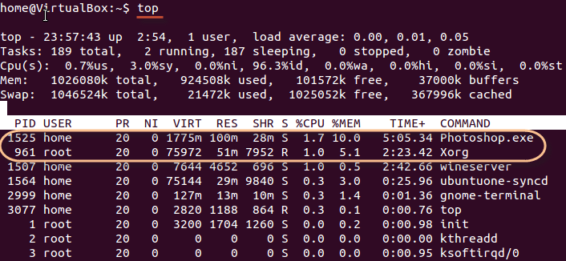
Top command : This utility tells the user about all the running processes on the Linux machine. Display all the running processes Syntax: $ top

Slide 39
Field | Description | Example 1 | Example 2
PID | The process ID of each task | 1525 | 961
User | The username of task owner | Home | Root
PR | Priority Can be 20(highest) or -20(lowest) | 20 | 20
NI | The nice value of a task | 0 | 0
VIRT | Virtual memory used (kb) | 1775 | 75972
RES | Physical memory used (kb) | 100 | 51
SHR | Shared memory used (kb) | 28 | 7952
S | Status There are five types: 'D' = uninterruptible sleep 'R' = running 'S' = sleeping 'T' = traced or stopped 'Z' = zombie | S | R
%CPU | % of CPU time | 1.7 | 1.0
%MEM | Physical memory used | 10 | 5.1
TIME+ | Total CPU time | 5:05.34 | 2:23.42
Command | Command name | Photoshop.exe | Xorg

Slide 40
Nice:
Starts a process with a given priority
Linux can run a lot of processes at a time, which can slow down the speed of some high priority processes and result in poor performance.
To avoid this, you can tell your machine to prioritize processes as per your requirements.
This priority is called Niceness in Linux, and it has a value between -20 to 19.
The lower the Niceness index, the higher would be a priority given to that task.
The default value of all the processes is 0.
To start a process with a niceness value other than the default value use the following syntax
Syntax: $ nice -n 'Nice value' process name
If there is some process already running on the system, then you can 'Renice' its value using syntax.
Syntax: renice 'nice value' -p 'PID'

Slide 41
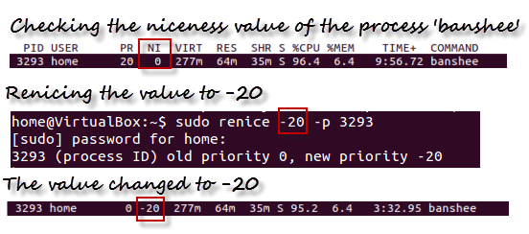
To change Niceness, you can use the 'top' command to determine the PID (process id) and its Nice value. Later use the renice command to change the value.

Slide 42
nohup :
When using the command shell, prefixing a command with nohup prevents the command from being aborted automatically when you log out or exit the shell.
The name nohup stands for "no hangup." The hangup (HUP) signal, which is normally sent to a process to inform it that the user has logged off (or "hung up"), is intercepted by nohup, allowing the process to continue running.
$ nohup sleep 200&
21343
$ ps aux | grep sleep

Slide 43
Disk utilities
The utilities which will display the information about the disk is known as the disk utilities.
The following mentioned are the disk utilities
which are used in common,
df
du
df COMMAND:
df command is used to find the empty disk space. Df stands for disk free.
Example:
$ df
Filesystem 1K-blocks Used Available Use% Mounted on
/dev/sda1 132239776 6210884 119311504 5% /
/tmpfs 4021876 0 4021876 0% /dev/shm
/dev/sdb2 30969600 117740 29278696 1% /home/oracle
/dev/sdc1 576310180 71232 546964104 1% /home/data
43

Slide 44
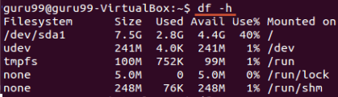
If you want the above information in a readable format, then use the command
$ df –h
Free :
This command shows the free and used memory (RAM) on the Linux system.
You can use the arguments
free -m to display output in MB
free -g to display output in GB

Slide 45
Disk utilities
Du COMMAND:
The du command displays the disk space used by the specified files and directories.
Syntax:
du [option]….[file]
Options:
–a: it writes counts for all files, not just for directories .
-b: it prints the size in bytes.
-c: it prints the grand total (i.e, the total disk space used by the directory).
-h: it prints the human readable formats.example1k,2g
-s: it does not show the size of sub-directories.
[mamta@localhost ~]$ du -a
8 ./.zshrc
8 ./f1
8 ./.bashrc
8 ./.kde/Autostart/.directory
16 ./.kde/Autostart
24 ./.kdehst
45
Notes:
45

Slide 46
To see the file size
$ du –sh new.tar
12k new.tar
to compress the tar file use gzip
$ gzip –v new.tar
$ ls
new.tar.gz
To check whether the file is compressed or not type
‘$ du –sh new.tar.gz
4.0k new.tar.gz

Slide 47
Networking commands
The commands which we will use for the communication between more than
one system for sharing resources or any other issue are known as the
networking commands.
Commands such as telnet, ftp, rlogin, finger are commonly used networking
commands.
telnet COMMAND:
telnet is a internet protocol which enables user to connect a remote system and
transfer data.
Syntax: $ telnet hostname or telnet ip_address
Example : $ telnet itctnss0123
Trying 164.130….
Connected to itctnss0123.
Escape character is ‘^]’.
SunOS 5.8
login: root
Password:
Last login: Thu Feb 24 16:13:12 from itctnss0123
Sun Microsystems Inc. SunOS 5.8 Generic Patch February 2004
47

Slide 48
Networking commands
Finger COMMAND:
The finger command is used to find out the details of a user, on both local and remote system.
Finger may be disabled on other systems for security reasons.
Following are the simple syntax to use finger command:
Check all the logged in users on local machine as follows:
Examples:
[amar@localhost ~]$ finger
Login Name Tty Idle Login Time Office Office Phone
amar pts/1 May 25 10:06 (172.16.10.5)
root root pts/0 7d May 16 14:03 (:0.0)
[amar@localhost ~]$ finger amar
Login: amar Name: (null)
Directory: /home/amar Shell: /bin/bash
On since Sat May 25 10:06 (IST) on pts/1 from 172.16.10.5
No mail.
No Plan.
48

Slide 49
Networking commands
Ftp is the user interface to the Internet standard File Transfer Protocol. The
program allows a user to transfer files to and from a remote network site.
This utility helps you to upload and download your file from one computer to
another computer.
The ftp utility has its own set of UNIX like commands which allow you to
perform tasks such as:
Connect and login to a remote host.
Navigate directories.
List directory contents
Put and get files
Transfer files as ascii, ebcdic or binary
Syntax:
Following is the simple syntax to use ping command:
$ftp hostname or ip-address
49

Slide 50
Networking commands
[amar@localhost ~]$ ftp amar
ftp: amar: unknown host
ftp> quit
[amar@localhost ~]$ ftp 172.16.1.254
ftp: connect: Connection refused
ftp>
ftp> quit
Command | Description
put filename | Upload filename from local machine to remote machine.
get filename | Download filename from remote machine to local machine.
mput file list | Upload more than one files from local machine to remove machine.
mget file list | Download more than one files from remote machine to local machine.
prompt off | Turns prompt off, by default you would be prompted to upload or download movies using mput or mget commands.
prompt on | Turns prompt on.
dir | List all the files available in the current directory of remote machine.
cd dirname | Change directory to dirname on remote machine.
lcd dirname | Change directory to dirname on local machine.
quit | Logout from the current login.
50

Slide 51
Networking commands
rlogin COMMAND:
rlogin command helps the user to log on to his identical remote account, with out using either the username or password.
The “rlogin” command is similar to telnet. The rlogin starts a terminal session on a remote host.
Syntax : $rlogin hostname
Example : 1) [amar@localhost ~]$ rlogin 172.16.1.254
connect to address 172.16.1.254 port 543: Connection refused
Trying krb4 rlogin...
connect to address 172.16.1.254 port 543: Connection refused
trying normal rlogin (/usr/bin/rlogin)
2) [amar@localhost ~]$ rlogin amar
amar: host unknown
Trying krb4 rlogin...
amar: host unknown
trying normal rlogin (/usr/bin/rlogin)
amar: Unknown host
51

Slide 52
Filters
a filter is a program that accepts input, transforms it and outputs the transformed data. The idea of the filter is closely associated with several ideas that are part of the UNIX operating system: standard input and output, input/output redirection and pipes.
Standard input and output refer to default locations from which a program will take input and to which it will write output. The standard input (STDIN) for a program running interactively at the command line is the keyboard; the standard output (STDOUT) is the terminal screen.
With input/output redirection, a program can take input or send output using a location other than standard input or output—a file, for example. Redirection of STDIN is accomplished using the < symbol, redirection of STDOUT by >.
52

Slide 53
Filters
cat COMMAND:
cat linux command concatenates files and print it on the standard output.
SYNTAX: $ cat [OPTIONS] [FILE]...
OPTIONS:
-A Show all.
-b Omits line numbers for blank space in the output.
-e A $ character will be printed at the end of each line prior to a new line.
-E Displays a $ (dollar sign) at the end of each line.
-n Line numbers for all the output lines.
-s If the output has multiple empty lines it replaces it with one empty line.
-T Displays the tab characters in the output.
-v Non-printing characters (with the exception of tabs, new-lines and form-feeds) are printed visibly.
Examples:
1. To Create a new file:
cat > file1.txt
This command creates a new file file1.txt. After typing into the file press control+d (^d) simultaneously to end the file.
53

Slide 54
Filters
2. To Append data into the file:
cat >> file1.txt
To append data into the same file use append operator >> to write into the file, else the file will be overwritten (i.e., all of its contents will be erased).
3. To display a file:
cat file1.txt
This command displays the data in the file.
4. To concatenate several files and display:
cat file1.txt file2.txt
The above cat command will concatenate the two files (file1.txt and file2.txt) and it will display the output in the screen. Some times the output may not fit the monitor screen. In such situation you can print those files in a new file or display the file using less command.
cat file1.txt file2.txt | less
54

Slide 55
Filters
5. To concatenate several files and to transfer the output to another file.
cat file1.txt file2.txt > file3.txt
In the above example the output is redirected to new file file3.txt. The cat
command will create new file file3.txt and store the concatenated output into
file3.txt.
Display beginning and end of files
head COMMAND:
head command is used to display the first ten lines of a file, and also specifies
how many lines to display
SYNTAX: $ head [options] filename
55

Slide 56
Filters
OPTIONS:
-n To specify how many lines you want to display.
-n number The number option-argument must be a decimal integer whose sign affects the location in the file, measured in lines.
-c number The number option-argument must be a decimal integer whose sign affects the location in the file, measured in bytes.
EXAMPLE:
head f1.txt
This command prints the first 10 lines of ' f1.txt '.
2. head -5 f1.txt
The head command displays the first 5 lines of ' f1.txt '.
3. head -c 5 f1.txt
The above command displays the first 5 characters of ' f1.txt '.
tail COMMAND:
Tail command is used to display the last or bottom part of the file. By default it displays last 10 lines of a file.
SYNTAX:
$ tail [options] filename
56

Slide 57
Filters
OPTIONS:
-b To specify the units of blocks.
-n To specify how many lines you want to display.
-c number The number option-argument must be a decimal integer whose sign affects the location in the file, measured in bytes.
-n number The number option-argument must be a decimal integer whose sign affects the location in the file, measured in lines.
EXAMPLE:
tail index.php
It displays the last 10 lines of 'index.php'.
2. tail -2 index.php
It displays the last 2 lines of 'index.php'.
3. tail -n 5 index.php
It displays the last 5 lines of 'index.php'.
4. tail -c 5 index.php
It displays the last 5 characters of 'index.php'.
57

Slide 58
Tail command also comes with an ‘+’ option which is not present in the head command. With this option tail command prints the data starting from specified line number of the file instead of end. For command: tail +n file_name, data will start printing from line number ‘n’ till the end of the file specified.
/mam123 $ cat hii
hii
how r u
fine thank you
bye
snist@snist-HP-Compaq-4000-Pro-SFF-PC:~/mam123$ tail +4 hii
fine thank you
bye

Slide 59
Filters
cut COMMAND:
cut command is used to cut out selected fields of each line of a file. The cut command uses delimiters to determine where to split fields.
SYNTAX:
cut [options]
OPTIONS:
-c Specifies character positions.
-b Specifies byte positions.
-d flags Specifies the delimiters and fields.
EXAMPLE:
cut -c1-3 text.txt
Output:
Thi
Cut the first three letters from the above line.
2. cut -d, -f1,2 text.txt
Output:
This is, an example program
The above command is used to split the fields using delimiter and cut the first two fields.
59

Slide 60
mam123$ cat hii
hii
how r u
fine thank you
bye
snist@snist-HP-Compaq-4000-Pro-SFF-PC:~/mam123$ cut -c1 hii
h
h
f
b
snist@snist-HP-Compaq-4000-Pro-SFF-PC:~/mam123$ cut -c2 hii
i
o
i
y

Slide 61
snist@snist-HP-Compaq-4000-Pro-SFF-PC:~/mam123$ cut -c -2 hii
hi
ho
fi
by
snist@snist-HP-Compaq-4000-Pro-SFF-PC:~/mam123$ cut -c 2- hii
ii
ow r u
ine thank you
ye

Slide 62
$ cat state.txt
Andhra Pradesh
Arunachal Pradesh
Assam
Bihar
Chhattisgarh
$ cut -b 1-3,5-7 state.txt
Andra
Aruach
Assm
Bihr
Chhtti
In this, 1- indicate from 1st byte to end byte of a line
$ cut -b 1- state.txt
Andhra Pradesh
Arunachal Pradesh
Assam
Bihar
hhattisgarh

Slide 63
In this, -3 indicate from 1st byte to 3rd byte of a line
$ cut -b -3 state.txt
And
Aru
Ass
Bih
Chh
-f (field): -c option is useful for fixed-length lines. Most unix files doesn’t have fixed-length lines. To extract the useful information you need to cut by fields rather than columns. List of the fields number specified must be separated by comma.Ranges are not described with -f option. cut uses tab as a default field delimiter but can also work with other delimiter by using -d option. Note: Space is not considered as delimiter in UNIX.
Like in the file state.txt fields are separated by space if -d option is not used then it prints whole line:
$ cut -f 1 state.txt
Andhra Pradesh
Arunachal Pradesh
Assam
Bihar C
hhattisgarh

Slide 64
If -d option is used then it considered space as a field separator or delimiter:
$ cut -d " " -f 1 state.txt
Andhra
Arunachal
Assam
Bihar
Chhattisgarh
Command prints field from first to fourth of each line from the file. Command:
$ cut -d " " -f 1-4 state.txt
Andhra Pradesh
Arunachal Pradesh
Assam
Bihar
Chhattisgarh

Slide 65
Filters
paste COMMAND:
paste command is used to paste the content from one file to another file. It is also used to set column format for each line.
Paste command is one of the useful commands in Unix or Linux operating system. It is used to join files horizontally (parallel merging) by outputting lines consisting of lines from each file specified, separated by tab as delimiter, to the standard output.
SYNTAX:
$ paste [options] [FILES]...
OPTIONS:
-s Paste one file at a time instead of in parallel.
-d Reuse characters from LIST instead of TABs .
EXAMPLE:
paste test.txt>test1.txt
Paste the content from 'test.txt' file to 'test1.txt' file.
2. ls | paste - - - -
List all files and directories in four columns for each line.
65

Slide 66
$ cat numbers
1
2
3
4
5
$ cat state
Arunachal Pradesh
Assam
Andhra Pradesh
Bihar
Chhattisgrah
$ cat capital
Tanagar
Dispur
Hyderabad
Patna
Raipur
$ paste number state capital
1 Arunachal Pradesh Itanagar
2 Assam Dispur
3 Andhra Pradesh Hyderabad
4 Bihar Patna
5 Chhattisgrah Raipur

Slide 67
d (delimiter): Paste command uses the tab delimiter by default for merging the files. The delimiter can be changed to any other character by using the -d option. If more than one character is specified as delimiter then paste uses it in a circular fashion for each file line separation.
Only one character is specified
$ paste -d "|" number state capital
1|Arunachal Pradesh|Itanagar
2|Assam|Dispur
3|Andhra Pradesh|Hyderabad
4|Bihar|Patna
5|Chhattisgrah|Raipur
More than one character is specified
$ paste -d "|," number state capital
1|Arunachal Pradesh,Itanagar
2|Assam,Dispur
3|Andhra Pradesh,Hyderabad
4|Bihar,Patna
5|Chhattisgrah,Raipur

Slide 68
-s (serial): We can merge the files in sequentially manner using the -s option. It reads all the lines from a single file and merges all these lines into a single line with each line separated by tab. And these single lines are separated by newline.
$ paste -s number state capital
1 2 3 4 5
Arunachal Pradesh Assam Andhra Pradesh Bihar Chhattisgrah
Itanagar Dispur Hyderabad Patna Raipur
In the above command, first it reads data from number file and merge them into single line with each line separated by tab. After that newline character is introduced and reading from next file i.e. state starts and process repeats again till all files are read.

Slide 69
Combination of -d and -s:
The following example shows how to specify a delimiter for sequential merging of files:
$ paste -s -d ":" number state capital
1:2:3:4:5
Arunachal Pradesh:Assam:Andhra Pradesh:Bihar:Chhattisgrah
Itanagar:Dispur:Hyderabad:Patna:Raipur

Slide 70
sort COMMAND:
sort command is used to sort the lines in a text file.
SORT command sorts the contents of a text file, line by line.
The sort command is a command line utility for sorting lines of text files. It supports sorting alphabetically, in reverse order, by number, by month and can also remove duplicates.
SYNTAX:
Sort [options] filename
OPTIONS:
-r Sorts in reverse order.
-u If line is duplicated display only once.
-o filename Sends sorted output to a file.

Slide 71
$ cat > file.txt
abhishek
chitransh
satish
Rajan
naveen
divyam
harsh
$ sort file.txt
Output :
abhishek
chitransh
divyam
harsh
naveen
rajan
satish

Slide 72
Sort function with mix file i.e. uppercase and lower case : When we have a mix file with both uppercase and lowercase letters then first the lower case letters would be sorted following with the upper case letters . Example:
Create a file mix.txt
$ cat > mix.txt
abc
apple
BALL
Abc
Bat
$ sort mix.txt
abc
Abc
apple
Bat
BALL

Slide 73
-o Option : Unix also provides us with special facilities like if you want to write the output to a new file, output.txt, redirects the output like this or you can also use the built-in sort option -o, which allows you to specify an output file. Using the -o option is functionally the same as redirecting the output to a file.
Syntax :
$ sort inputfile.txt > filename.txt
$ sort -o filename.txt inputfile.txt
Ex:
$ sort file.txt > output.txt
$ sort -o output.txt file.txt
$ cat output.txt
abhishek
chitransh
Divyam
harsh
naveen
rajan
satish

Slide 74
Filters
tr COMMAND:
tr filter translates specified characters into other characters.
Syntax:
tr [options] string1 string2
Options
-c : complements the set of characters in string.i.e., operations apply to characters not in the given set -d : delete characters in the first set from the output. -s : replaces repeated characters listed in the set1 with single occurrence
Translates any character read from stdin that is in string1 into the corresponding character from string2; otherwise the character is simply passed through.
string1 and string2 normally have the same number of characters.
Eg tr abc X5Z
translates a into X, b into 5 and c into Z.
74
Notes:
74

Slide 75
$ cat > f1
a
B
C
D
E
F
G
H
i
$ cat f1 | tr ‘a-i’ ‘1-9’
o/p:
$ echo “ welcome to linux” | tr ‘w’ ‘x’
o/p :
xelcome to linux

Slide 76
How to convert lower case to upper case
$ cat > sort123
WELCOME TO
linux programming
$ cat sort123 | tr “[a-z]” “[A-Z]”
WELCOME TO
LINUX PROGRAMMING
(OR)
$cat SORT123 | tr “[:lower:]” “[:upper:]”
$ cat SORT123 | tr “[:lower:]” “[:upper:]” “[:upper:]” “[:lower:]”
How to translate white-space to tabs
$ echo "Welcome To LIINUX " | tr [:space:] '\t'

Slide 77
How to delete specified characters using -d option To delete specific characters use the -d option.This option deletes characters in the first set specified.
$ echo "Welcome To LINUX" | tr -d 'w‘
Output:
elcome To LINUX
To remove all the digits from the string, use
$ echo "my ID is 73535" | tr -d [:digit:]
Output:
my ID is

Slide 78
How to complement the sets using -c option
You can complement the SET1 using -c option. For example, to remove all characters except digits, you can use the following.
$ echo "my ID is 73535" | tr -cd [:digit:]
Output:
73535

Slide 79
-s (option ) : : Replaces repeated characters listed in the set1 with single occurrence
$ cat > f2
welcome to linux programming
Linux programming is interesting
Linux is an operation syster
$ cat f2 | tr –s [+m]
o/p:
How to squeeze multiple blank spaces to a single blank space
$ cat f2 | tr –s ‘[:blank:] ‘
o/p:

Slide 80
Filters
uniq COMMAND:
uniq assumes lines of ASCII file are sorted and deals with unique lines depending on the option given.
No option, one copy of each unique line is printed to stdout. Duplicated lines are discarded.
Eg $ uniq dups
dups: default output:
A a
b b
b c
c dd
dd ddd
ddd
ddd
Ddd
-u option prints only those lines that have no duplicates.
Eg uniq -u dups
dups: -u output:
a a
b c
b dd
c
80

Slide 81
Filters
-d option prints only those lines that have duplicates.
Eg uniq -d dups
output:
a b
b ddd
b
c
dd
ddd
ddd
ddd
uniq runs as filter or as program driving a pipeline.
There are options to compare fields and to count duplicated lines.
81

Slide 82
Filters
Wc COMMAND:
The purpose of wc command is to count the number of lines,words,characters in a particular file or files
Syntax: $ wc filename
Example:
$ wc file1
40 200 file1
First column represents number of lines
Second column represents number of words
Third column represents number of charcters
Fourth column shows the file name
OPTIONS:
-l (line)
-w (words)
-c (character)
82

Slide 83
Filters
cmp COMMAND:
Compares two files and tells you what line numbers are different.
By default location of first mismatch is displayed
Syntax: $ cmp [-options] filename1 filename2
-l this option displays the list of all differences present in the file byte- by-byte.
-s Write nothing for differing files; return exit status(‘0’ or ‘1’) only.
the ‘0’ specifies that two files are similar and ‘1’ specifies that there is at least one that is different.
83

Slide 84
Text processing utilities
The operations performed by the text processing utilities are as follows
Processing the text
Modifying the content of files
Deleting words and charlacters form files
cat: cat is used to create the files.
$cat> filename
Type some text here
Press ctrl+d
$
Cat can also be used to display the contents Of a file.
$cat filename
Cat can also concatenate the contents of 2 files and store them in third file.
Cat>file1 file2>new file
To append the contents of two files into another file use
Cat>file1 file2>>new file
84

Slide 85
Text processing utilities
tail:
tail command displays the end of the file. It displays the last ten lines by default.
$tail file
To display last 3 lines use
$tail –n 3 file or
$tail -3 file
We can also address the lines from the beginning of the file instead of the end.
The + count allows to do that.
85

Slide 86
Text processing utilities
head:
head command as the name implies, displays the top of the file. When used without an option, it displays the first 10 lines of the file.
$head file
We can use –n option to specify a line count and display, say first 3 lines of the file.
$head –n 3 file or $head -3 file
Sort:
Sort can be used for sorting the contents of a file.
$sort shortlist
Sorting starts with the first character of each line and proceeds to the next character only when the characters in two lines are identical.
Sort options:
With –t option sorts a file based on the fields.
51
Notes:
86

Slide 87
Text processing utilities
$sort –t “|” +2 shortlist
The sort order can be reversed with –r option.
Sorting on secondary key:
U can sort on more than one field i.e. u can provide a secondary key to sort.
If the primary key is the third field and the secondary key the second field, we can use
$sort –t \| +2 -3 +1 shortlist
Numeric sort (-n):
To sort on number field use sort with –n option.
$sort –t: +2 -3 –n group1
Removing duplicate lines (-u):
The –u option u purge duplicate lines from a file.
52

Slide 88
Text processing utilities
nl:
nl is used for numbering lines of a file.
Nl numbers only logical lines –those containing something other apart from the new line character.
$nl file
nl uses a tab as a default delimiter, but we can change it with –s option.
$nl –s: file
nl won’t number a line if it contains nothing.
53

Slide 89
Grep: globally search for a regular expression and print.
Grep scans a file for the occurrence of a pattern and depending on the options used, displays
Lines containing the selected pattern.
Lines not containing the selected pattern (-v).
Line numbers where pattern occurs (-n)
No. of lines containing the pattern (-c)
File names where pattern occurs (-l)
Syntax:
grep option pattern filename(s)

Slide 90
$cat > geekfile.txt
unix is great os. unix is opensource.
unix is free os. learn operating system.
Unix linux which one you choose.
uNix is easy to learn.unix is a multiuser os
Learn unix .unix is a powerful.
-i : Case insensitive search : The -i option enables to search for a string case insensitively in the give file.
$grep -i "UNix" geekfile.txt
o/p

Slide 91
-c : Displaying the count of number of matches : We can find the number of lines that matches the given string/pattern
$grep -c "unix" geekfile.txt
Output:
-l : Display the file names that matches the pattern : We can just display the files that contains the given string/pattern.
$grep -l "unix" *
Or
$grep -l "unix" f1.txt f2.txt f3.xt f4.txt
Output:
geekfile.txt

Slide 92
-o : Displaying only the matched pattern : By default, grep displays the entire line which has the matched string. We can make the grep to display only the matched string by using the -o option.
$ grep -o "unix" geekfile.txt
Output:
unix
unix
unix
unix
-n : Show line number while displaying the output using grep -n : To show the line number of file with the line matched.
$ grep -n "unix" geekfile.txt
Output:
1:unix is great os. unix is opensource. unix is free os.
4:uNix is easy to learn.unix is a multiuser os.Learn unix .unix is a powerful.

Slide 93
-v : Inverting the pattern match : You can display the lines that are not matched with the specified search sting pattern using the -v option.
$ grep -v "unix" geekfile.txt
Output:
learn operating system. Unix linux which one you choose.
Matching the lines that start with a string : The ^ regular expression pattern specifies the start of a line. This can be used in grep to match the lines which start with the given string or pattern.
$ grep "^unix" geekfile.txt
Output:
unix is great os. unix is opensource. unix is free os.

Slide 94
Matching the lines that end with a string : The $ regular expression pattern specifies the end of a line. This can be used in grep to match the lines which end with the given string or pattern.
$ grep "os$" geekfile.txt

Slide 95
Text processing utilities
Egrep: extended grep
Egrep extended set includes 2 special characters + and ?.
+ --matches one or more occurrences of the pervious character.
?-- matches zero or more occurrences of the pervious character.
Create a table like below :
100 Thomas Manager Sales $5,000
200 Jason Developer Technology $5,500
300 Sanjay Sysadmin Technology $7,000
400 Nisha Manager Marketing $9,500
500 Randy DBA Technology $6,000
95

Slide 96
Search for Specific Characters :
The following example searches for either J, or N, or R.
$ egrep [JNR] employee.txt
200 Jason Developer Technology $5,500
400 Nisha Manager Marketing $9,500
500 Randy DBA Technology $6,000
Search for a Range
The following example searches the range 6-9. i.e It searches for 6, or 7, or 8, or 9
$ egrep [6-9] employee.txt
300 Sanjay Sysadmin Technology $7,000
400 Nisha Manager Marketing $9,500
500 Randy DBA Technology $6,000

Slide 97
egrep OR Example
Pipe symbol is used for egrep OR. The following searches for either Marketing or DBA.
$ egrep 'Marketing|DBA' employee.txt
400 Nisha Manager Marketing $9,500
500 Randy DBA Technology $6,000

Slide 98
fgrep: fast grep
If search criteria requires only sequence expressions, fgrep is the best utility.
Fgrep supports only string patterns, no regular expressions.
The fgrep command differs from the grep and egrep commands because it searches for a string instead of searching for a pattern that matches an expression.
The fgrep command uses a fast and compact algorithm
The $, *, [, |, (, ), and \ characters are interpreted literally by the fgrep command, These characters are not interpreted as parts of a regular expression, as they are interpreted in the grep and egrep command.
The entire string must be enclosed in single quotation mark ('...'). If no files are specified, the fgrep command assumes standard input.

Slide 99
Syntax : fgrep options string filename
(or)
grep –f pattern filename
To extract all the lines that contain an apostrophe use fgrep as follows:
$fgrep “’” file
To search several files for a simple string of characters:
$ fgrep "strcpy“ *.c
this searches for the string strcpy in all files in the current directory with names ending in the .c character string.

Slide 100
To display the names of files that contain a pattern:
$ fgrep -l "strcpy“ *.c
This searches the files in the current directory that end with .cand displays the names of those files that contain the strcpy string.

Slide 101
Text processing utilities
Cut: slitting the file vertically
U can slice a file vertically with cut command.
Cutting columns(-c):
Cut with –c option cuts the columns.
To extract first 4 columns of the group file :
$cut –c 1-4 group1
The specification –c 1-4 cuts columns 1 to 4.
Cutting fields:
To cut 1st and 3rd fields use
$cut –d: -f1,3 group1
101

Slide 102
Text processing utilities
Paste: pasting files
What u cut with the cut can be pasted back with paste command-but vertically rather than horizontally. u can view two files side by side by pasting them.
To join two files calc.lst and result.lst use
$paste –d= calc.lst result.lst
Join:
is a command in Unix-like operating systems that merges the lines of two sorted text files based on the presence of a common field.
The join command takes as input two text files and a number of options. If no command-line argument is given, this command looks for a pair of lines from the two files having the same first field (a sequence of characters that are different from space), and outputs a line composed of the first field followed by the rest of the two lines.
$join file1 file2
102
Notes:
102

Slide 103
join command is used to join the two files based on a key field present in both the files. The input file can be separated by white space or any delimiter.
Syntax: join [OPTION] FILE1 FILE2
Ex:
$cat file1.txt
1 AAYUSH
2 APAAR
3 HEMANT
4 KARTIK
// displaying contents of second file //
$cat file2.txt
1 101
2 102
3 103
4 104

Slide 104
Now, in order to combine two files the files must have some common field. In this case, we have the numbering 1, 2... as the common field in both the files.
NOTE : When using join command, both the input files should be sorted on the KEY on which we are going to join the files.
$ join file1.txt file2.txt
1 AAYUSH 101
2 APAAR 102
3 HEMANT 103
4 KARTIK 104
// by default join command takes the first column as the key to join as in the above case //

Slide 105
using -a FILENUM option : Now, sometimes it is possible that one of the files contain extra fields so what join command does in that case is that by default, it only prints pairable lines. For example, even if file file1.txt contains an extra field provided that the contents of file2.txt are same then the output produced by join command would be same:
$cat file1.txt
1 AAYUSH
2 APAAR
3 HEMANT
4 KARTIK
5 DEEPAK
//displaying contents of file2.txt//
$cat file2.txt
1 101
2 102
3 103
4 104

Slide 106
$join file1.txt file2.txt
1 AAYUSH 101
2 APAAR 102
HEMANT 103
4 KARTIK 104
// although file1.txt has extra field the output is not affected cause the 5 column in file1.txt was unpairable with any in file2.txt//
/using join with -a option// //1 is used with -a to display the contents of first file passed//
$join file1.txt file2.txt -a 1
1 AAYUSH 101
2 APAAR 102
3 HEMANT 103
4 KARTIK 104
5 DEEPAK

Slide 107
using -v option : Now, in case you only want to print unpairable lines i.e suppress the paired lines in output then -v option is used with join command.
$join file1.txt file2.txt -v 1
5 DEEPAK
using -1, -2 and -j option : As we already know that join combines lines of files on a common field, which is first field by default.However, it is not necessary that the common key in the both files always be the first column.join command provides options if the common key is other than the first column.
The -1 and -2 here represents he first and second file and these options requires a numeric argument that refers to the joining field for the corresponding file.

Slide 108
$cat file1.txt
AAYUSH 1
APAAR 2
HEMANT 3
KARTIK 4
cat file2.txt
101 1
102 2
103 3
104 4
$join -1 2 -2 2 file1.txt file2.txt
1 AAYUSH 101
2 APAAR 102
3 HEMANT 103
4 KARTIK 104
//here -1 2 refers to the use of 2 column of first file as the common field and -2 2 refers to the use of 2 column of second file as the common field for joining//

Slide 109
Back up utilities
The two back up utilities are used in Linux. They are,
Cpio
Tar
cpio COMMAND: copy input-output
Cpio command copies files to and from a backup device. It uses standard input to take the list of filenames.
It then copies them with their contents and headers into stream which can be redirected to a file or a device.
Cpio can be used with redirection and piping.
Cpio uses two options-o (output) and –i (input) either of which must be there in the command line.
109

Slide 110
Back up utilities
tar COMMAND : the tape archive program
Tar doesn’t normally write to the standard output but creates an archive in the media.
Tar accepts file and directory names as arguments.
It operates recursively.
It can create several versions of same file in a single archive.
It can append to an archive without overwriting the entire archive.
-c option is used to copy files to backup device.
$tar –cvf /dev/rdsk/foq18dt /home/sales/sql/*.sql
The verbose option (-v) shows the no. of blocks used by each file.
Files are restored with the –x (extract) key option. when no file or directory name is specified it restores all files from the backup device.
110

Slide 111
To create a tar file
$ mkdir dir12
$ cd dir12
dir12$ touch f1 f2 f3 f4 f5 f6
$ tar –cvf dir123.tar dir12
$ ls
Dir123.tar
To see the file size
$ du –sh dir123.tar
120k dir123
To compress tar file gzip
$ gzip dir123.tar

Slide 112
To compress tar.gz file use bzip2
$ bzip2 –v dir123.tar.gz
$ dir123.tar.gz.bz2
To extract bz2 files
$bunzip –v dir123.tar.gz.bz2
To extract gz files
$gunzip –v dir123.tar.gz
Dir123.tar
To view tar file
$ tar –tvf dir123.tar
To extract tar file
$ tar –xvf dir123.tar

Slide 113
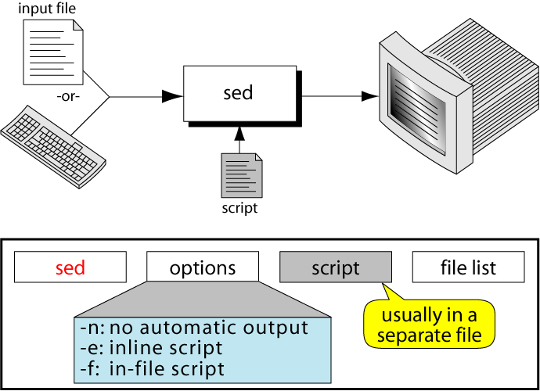
Sed
Sed is one of the most powerful filters. it stands for stream editor. Despite its name editing, it does not modify the original file. It reads the standard input (a keyboard or file), processes it using a separate file called sed script and writes the standard output.
62

Slide 114
Sed
Options:
-e: it is a default option. It indicates that the script is on the command line.
-f: it indicates that script is in a file which immediately follows this option.
-n: it suppresses the automatic output. That is, it will not display the contents of the pattern space.
62

Slide 115
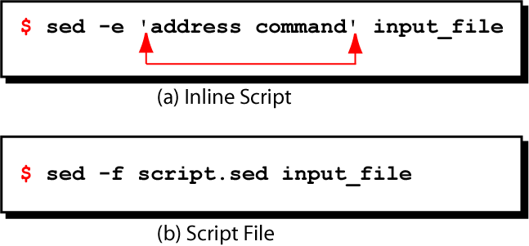
Scripts, Operation
A script is nothing more than a file of commands or instructions.
Each command consists of an address and an action, where the address can be a pattern (regular expression)
address | ! | Action
Complement operator(optional)
A Sed instruction
61

Slide 116
Scripts
Here is an example of sed script namely sample.sed
Sample.sed
# this is one line comment
#this is another comment
3d
1,10s/friends/buddies/
In the sample script, the first two line are the comments. The third and fourth lines are the instructions. The former specifies the third line in the input file is to be deleted while the later specifies to replace all occurrences of “friends” by “buddies ” in the input lines 1 through 10.
61

Slide 117
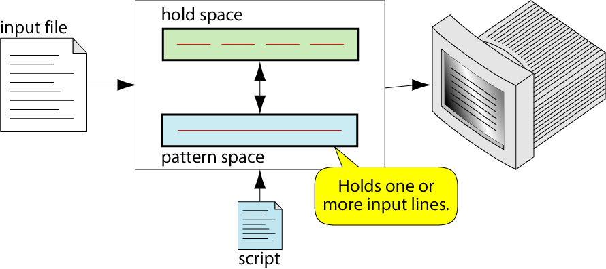
Scripts, Operation
As each line of the input file is read, sed reads the first command of the script and checks the address or pattern against the current input line
If there is a match, the command is executed
If there is no match, the command is ignored
61

Slide 118
Addresses
Address determines which lines in the input file are to be processed by the command(s)
if no address is specified, then the command is applied to each input line
Address types:
Single-Line address
Set-of-Lines address
Range address
Nested address
Single-Line Address
Specifies only one line in the input file
special: dollar sign ($) denotes last line of input file
66

Slide 119
Addresses
Examples:
show only line 3
sed -n -e '3 p' input-file
show only last line
sed -n -e '$ p' input-file
substitute ―”endif” with ―”fi” on line 10
sed -e '10 s/endif/fi/' input-file
Set-of-Lines Address
use regular expression to match lines
written between two slashes
process only lines that match
may match several lines
lines may or may not be consecutives
Examples:
/^A/command (Matches all lines that start with ‘A’)
/^$/colmmand (Matches blank lines)
67

Slide 120
Addresses
Range Address
Defines a set of consecutive lines
Format:
start-addr,end-addr (inclusive)
following are the possible combinations
10,50 line-number,line-number
10,/R.E/ line-number,/RegExp/
/R.E./,10 / RegExp/,line-number
/R.E./,/R.E/ /RegExp/,/RegExp/
Examples :
4,9 (Matches all lines 4 through 9)
2,/^A/command (starts matching from line 2 to a line that starts with A)
/^A/,15 (starts matching from a line that begins with A to 15)
/^A/,/$B/command (starts matching from a line that begins with A to a line that ends with B)
68

Slide 121
$ sed –n ‘3-6p’ f1.txt
To print the lines other than 3-6 use !
$ sed –n ‘ 3,6!p’ f1.txt
$ sed –n ‘/[cC]omputers/p’ f1.txt

Slide 122
Addresses
Nested Address
Nested address contained within another address
Example:
To delete all blank lines between line 11 and 20 the instruction is as follows
11,20,{
/^$/ d
}
To delete all the lines that contain the word “Happy” as well as “life” is as follows
/Happy/ {
/life/d
}
print lines that do not contain “obsolete”
sed -e ‘/obsolete/!p’ input-file
69

Slide 123
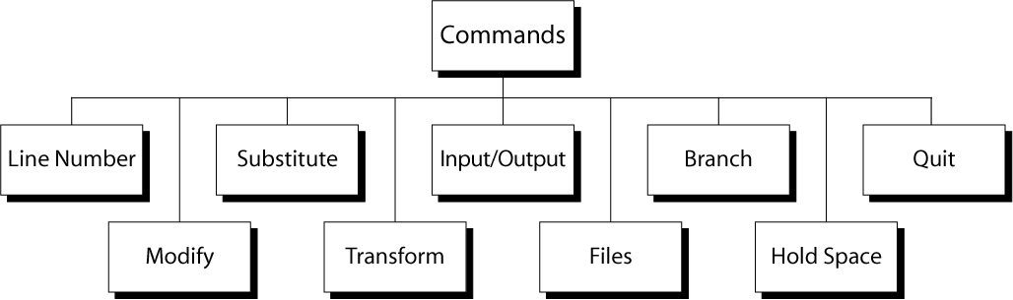
Commands
Line Number
line number command (=) writes the current line number before each matched/output line
Example:
$ sed ‘=‘ twister.dat
This command print the file twister.dat with line number
70

Slide 124
sed ‘=’ command accepts only one address, so if you want to print line number for a range of lines, you must use the curly braces.
Syntax:
# sed -n '/PATTERN/,/PATTERN/ {
=
p
}' filename
Print the line numbers for the lines matches from the pattern “Oracle” to “Productivity”.
$ sed -n '/Oracle/,/Productivity/{
=
p
}' f1.txt
o/p:
2
Databases - Oracle, mySQL etc.
3
Security (Firewall, Network, Online Security etc)
4
Storage in Linux
5
Productivity (Too many technologies to explore, not much time available)

Slide 125
Find the line number which contains the pattern
The below sed command prints the line number for which matches with the pattern “Databases”
$ sed -n '/Databases/=' f1..txt
o/p :
2
Print the total number of lines in a file
Line number of the last line of the file will be the total lines in a file. Pattern $ specifies the last line of the file.
$ sed -n '$=' f1.txt
6

Slide 126
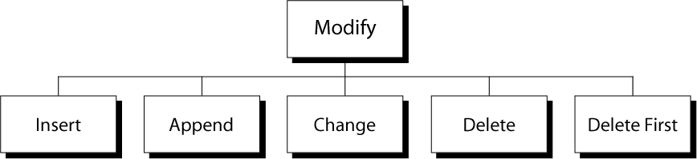
Commands
Insert Command: I
adds one or more lines directly to the output before the address:
inserted “text” never appears in sed‘s pattern space
cannot be used with a range address; can only be used with the single-line and set-of-lines address types
Syntax:
[address] i\
text \
71

Slide 127
1. Add a line before the 4th line of the line:
Ex: $ cat f.txt
Linux Sysadmin
Databases - Oracle, mySQL etc.
Security (Firewall, Network, Online Security etc)
Storage in Linux
Productivity (Too many technologies to explore, not much time available) Windows- Sysadmin, reboot etc.
$ sed '4 i\ Cool gadgets and websites' f.txt
Linux Sysadmin
Databases - Oracle, mySQL etc.
Security (Firewall, Network, Online Security etc)
Cool gadgets and websites
Storage in Linux
Productivity (Too many technologies to explore, not much time available) Windows- Sysadmin, reboot etc.

Slide 128
2. Insert a line before every line with the pattern
$ sed '/Sysadmin/i \ Linux Scripting' thegeekstuff.txt
o/p :
Linux Scripting
Linux Sysadmin
Databases - Oracle, mySQL etc.
Security (Firewall, Network, Online Security etc)
Storage in Linux
Productivity (Too many technologies to explore, not much time available)
Linux Scripting
Windows- Sysadmin, reboot etc.

Slide 129
3. Insert a line before the last line of the file.
Insert a line “Website Design” before the last line of the file.
$ sed '$ i\ Website Design' thegeekstuff.txt
o/p :
Linux Sysadmin Databases - Oracle, mySQL etc.
Security (Firewall, Network, Online Security etc)
Storage in Linux
Productivity (Too many technologies to explore, not much time available)
Website Design
Windows- Sysadmin, reboot etc.

Slide 130
Commands
Append Command: a
adds one or more lines directly to the output after the address:
Similar to the insert command (i), append cannot be used with a range address.
Appended ―text‖ does not appear in sed‘s pattern space.
Syntax:
[address] a\
text
EX:
Script.sed
#script to append the text at the end of the file
$a\
Is it difficult? Try again!
72

Slide 131
Addresses
Change Command: c
replaces the lines matching the address with x:new text
accepts four address types:
single-line, set-of-line, range, and nested addresses.
Syntax:
[address1[,address2]] c\
text
Ex: $sed –f script.sed twister.dat
Script.sed
5c\
Red Blood Blue Blood\
Deadly Dinosaurs Danced Dizzly
o/p:
Bad Black Bread
Fresh Fried Fish
69

Slide 132
Commands
Six Thick Thistle Sticks
Short Socks with Spots
Red Blood Blue Blood
Deadly Dinosaurs Danced Dizzly
I Scream ,You Scream, We all Scream for Ice Cream
Delete Command:
There are 2 versions of delete commands
d: it deletes all the lines in the pattern space
D:it deletes only the first line of the pattern space
Syntax:
[address1[,address2]] d
73

Slide 133
Commands
Ex: to delete all the lines that starts with a capital letter either B or I
$sed ‘/^[BI]/d’ twister.dat
o/p:
Fresh Fried Fish
Six Thick Thistle Sticks
Short Socks with Spots
73

Slide 134
Commands
Substitute command:
The substitute command, replaces the text matching the search pattern with a replacement string.
Syntax:
[address(es)]s/pattern/replacement/[flags]
pattern - search pattern
replacement - replacement string for pattern
flags - optionally any of the following
n it replaces only the specified occurrence of pattern
Here n is an integer
g it replaces all occurrences of a pattern in pattern space
By default it replaces the first occurrences of a pattern
p print contents of pattern spac
W it writes a file
76

Slide 135
Commands
Transform command(y):
The Transform command (y) operates like tr, it does a one-to-one or character-to-character replacement
Transform accepts zero, one or two addresses
[address[,address]]y/abc/xyz/
every a within the specified address(es) is transformed to an x. The same is true for b to y and c to z
y/abcdefghijklmnopqrstuvwxyz/ABCDEFGHIJKLMNOPQRSTUVWXYZ/ changes all lower case characters on the addressed line to upper case
79

Slide 136
Commands
sed i/o commands :
There are 5 i/o commands
1.Next 2.Append next 3.Print
4.Print first line 5.List
1.Next:
The next command, n reads the next line from the input file into the pattern space. before reading the next line , it sends the current contents of the pattern space to the standard output, deletes the current line in it and then copies the next line
Ex:the command to delete a blank line if it appears after a line that starts with a digit is given below
$sed –f myscript.sed file1.dat
80

Slide 137
Commands
Myscript.sed
#script to demonstrate the next command
/^[0-9]/{
n
/^$/d
}
2 .Append Next(N):
The append next command, adds the next input line to the current contents of the pattern space
This command is useful when applying patterns to two or more lines at the same time.
Ex : the command to append next line to the current line if the current line ends with a colon(:)
li
81

Slide 138
Commands
Script.sed
/:$/N
#replace the new line with a single space
s/\n/ /
3.Print(p)
The Print command (p) prints the current content of the pattern space to standard otput, useful if the -n option has been specified
Syntax: [address1[,address2]]p
Note: if the –n option has not been specified, p will cause the line to be output twice!
Examples:
$sed –n ‘1,5p’ file1.dat it prints the lines from 1 to 5.
/^$/,$p will display the lines from the first blank line through the last line of the fie
suma
82

Slide 139
Commands
4.Print first line(P)
It prints only the first line of the pattern space. it stops print when it finds a new line character.
List Command
5.List(l)
The list command, l converts the unprintable characters into printable characters. it prints the octal value of the unprintable characters where each octal value is preceded by’\’ character
Ex:
$sed –n ‘|’ myfile.dat
Myile.dat
This is a tab and new line
Another tab
83

Slide 140
Commands
Out put:
This is a tab\t and newline$
\t another tab.$
File commands
allows to read and write from/to file while processing standard input
read: r command
write: w command
Read File command
Syntax: r filename
Ex: write the command to insert the content of file2.txt before the contents of file1.txt
$ sed ‘ 1r file2.txt ’ file1.txt
84

Slide 141
Commands
Ex: write the command to save first 20 lines from file1.txt to a file output.txt
$ sed –n1,20w output.txt file1.txt
Quit
Quit causes sed to stop reading new input lines and stop sending them to standard output
It takes at most a single line address
Once a line matching the address is reached, the script will be terminated
This can be used to save time when you only want to process some portion of the beginning of a file
Example: to print the first 100 lines of a file (like head) use:
sed '100q' filename
sed will, by default, send the first 100 lines of filename to standard output and then quit processing
85

Slide 142
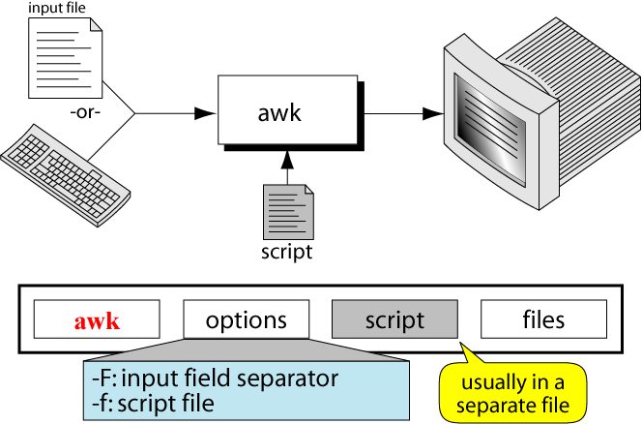
Awk
The awk utility, which takes its name from the initials of its authors (Aho, Weinberger, and Kernighan), is a powerful programming language.
86

Slide 143
Execution
In addition to input data, awk also requires one or more instructions that provide editing instructions.
A few instructions can be entered at the command line from the keyboard.
Most of the time, the instructions are placed in a file known as an awk script.
Syntax
$awk options awk scripts file(s)
Options
-f: it indicates that script is in a file which immediately follows this option.
-F:this option specifies the input field seperator. By default, it is space or a tab.
Ex:
$awk –F “\t” –f firstscript.awk info.dat
87

Slide 144
Fields and Records
The awk utility views a file as a collection of fields and records.
A field is a unit of data that has informational content.
Each field of information is separated by one or more whitespace characters or other separator.
Each line is a record. A record is a collection of fields.
When a file is organized into records, we call it a data file, as contrasted with a text file.
awk also can handle a text file.
88

Slide 145
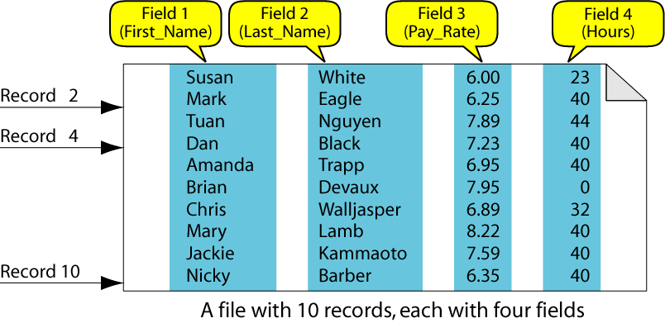
A Data File
89

Slide 146
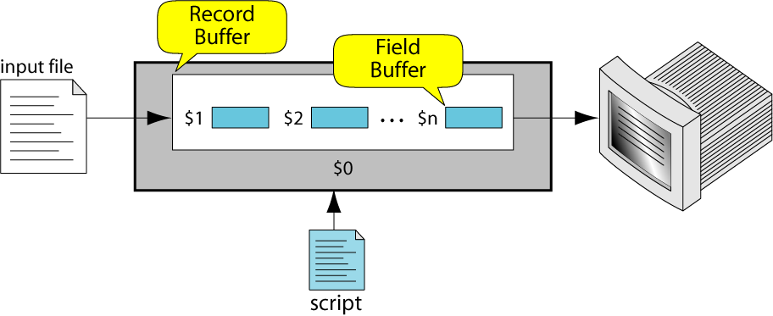
Field Buffers
There are as many field buffers available as there are fields in the current record of the input file.
Each buffer has a name, which is the dollar sign $ followed by the field number in the current record.
90

Slide 147
Record Buffer
There is only one record buffer available. Its name is $0.
It holds the whole record.
91

Slide 148
System Variables
FS Input field separator
RS Input record separator
OFS Output field separator
ORS Output record separator
NF Number of nonempty fields in a record
NR Number of records read from all files
FNR Number of records in current file
FILENAME Name of the current file
92

Slide 149
System Variables
Examples :
% cat emps
Tom Jones 4424 5/12/66 543354
Mary Adams 5346 11/4/63 28765
Sally Chang 1654 7/22/54 650000
Billy Black 1683 9/23/44 336500
% awk '{print NR, $0}' emps
1 Tom Jones 4424 5/12/66 543354
2 Mary Adams 5346 11/4/63 28765
3 Sally Chang 1654 7/22/54 650000
4 Billy Black 1683 9/23/44 336500
92

Slide 150
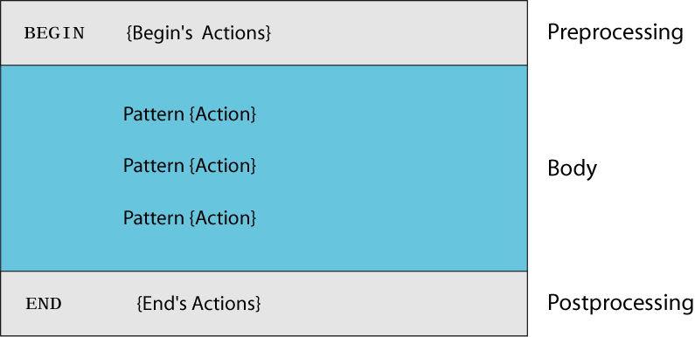
awk Script Design
93

Slide 151
Recursive representation of Factorial(4)
awk Script
BEGIN: pre-processing
performs processing that must be completed before the file processing starts (i.e., before awk starts reading records from the input file)
useful for initialization tasks such as to initialize variables and to create report headings
BODY: Processing
contains main processing logic to be applied to input records
like a loop that processes input data one record at a time:
if a file contains 100 records, the body will be executed 100 times, one for each record
94

Slide 152
awk Script
END: post-processing
contains logic to be executed after all input data have been processed
logic such as printing report grand total should be performed in this part of the script
95

Slide 153
Operations
The awk utility reads an input file, line by line and applies all the instructions in awk script to each input line. It does not print the lines unless the print action is specified .consider a records .dat with five fields i.e,s.no,name,test1,test2,test3 and four records.
1 A 75 81 89
2 B 86 94 82
3 C 90 71 96
4 D 82 70 85
$awk –f total.awk records.dat
Total.awk
#initialization section
BEGIN {print “name\t total”}
96

Slide 154
Operations
#body section
{total=$3+$4+$5}
{print $2+”\t” total}
#END of job
END {print “Best Result”}
Output:
Name total
A 245
B 262
C 257
D 237
Best Result
97

Slide 155
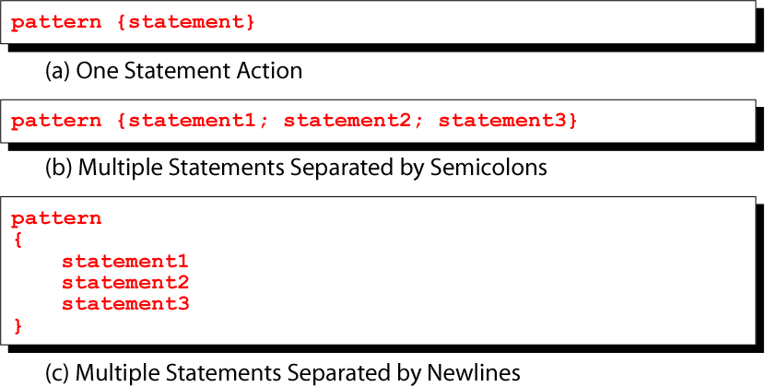
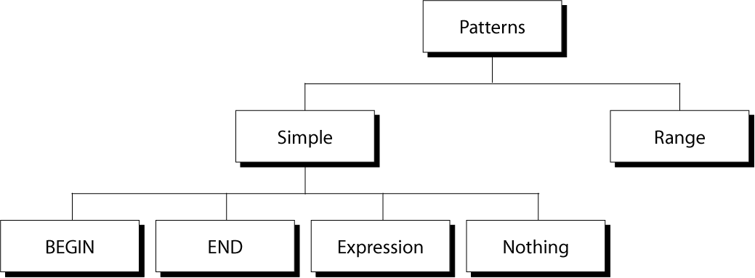
Pattern/Action
suma
98

Slide 156
Expression Pattern types
match
entire input record
regular expression enclosed by ‘/’s
explicit pattern-matching expressions
~ (match), !~ (not match)
expression operators
arithmetic
relational
logical
99

Slide 157
Example: match input record
% cat employees2
Tom Jones:4424:5/12/66:543354
Mary Adams:5346:11/4/63:28765
Sally Chang:1654:7/22/54:650000
Billy Black:1683:9/23/44:336500
% awk –F: '/00$/' employees2
Sally Chang:1654:7/22/54:650000
Billy Black:1683:9/23/44:336500
100

Slide 158
Arithmetic Operators
Operator Meaning Example
+ Add x + y
- Subtract x – y
* Multiply x * y
/ Divide x / y
% Modulus x % y
^ Exponential x ^ y
Example:
% awk '$3 * $4 > 500 {print $0}' file
103

Slide 159
Relational Operators
Operator Meaning Example
< Less than x < y
< = Less than or equal x < = y
== Equal to x == y
!= Not equal to x != y
> Greater than x > y
> = Greater than or equal to x > = y
~ Matched by reg exp x ~ /y/
!~ Not matched by req exp x !~ /y/
104

Slide 160
Logical Operators
Operator Meaning Example
&& Logical AND a && b
|| Logical OR a || b
! NOT ! a
Examples:
% awk '($2 > 5) && ($2 <= 15)
{print $0}' file
% awk '$3 == 100 || $4 > 50' file
105

Slide 161
Logical Operators
Operator Meaning Example
&& Logical AND a && b
|| Logical OR a || b
! NOT ! a
Examples:
% awk '($2 > 5) && ($2 <= 15)
{print $0}' file
% awk '$3 == 100 || $4 > 50' file
105

Slide 162
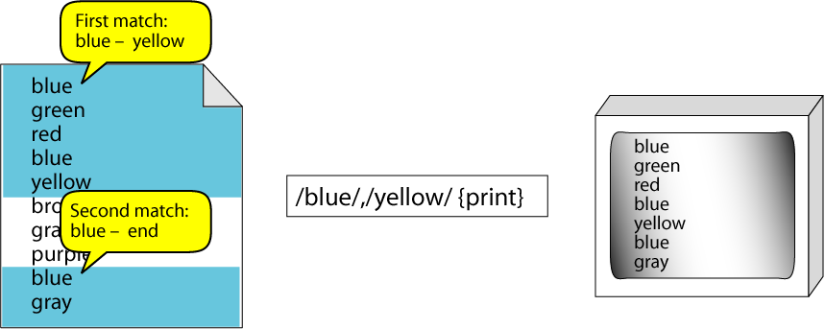
Range Patterns
Matches ranges of consecutive input lines
Syntax:
pattern1 , pattern2 {action}
pattern can be any simple pattern
pattern1 turns action on
pattern2 turns action off
Example:
106

Slide 163
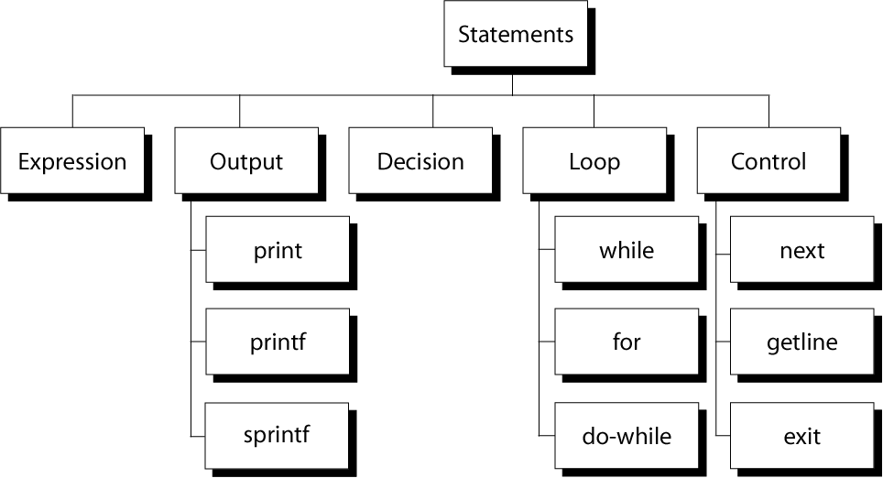
awk Actions
The first job of a preprocessor is file inclusion - the copying of one or more files into programs.
The files are usually header files consisting declarations of predefined functions and external files containing functions and data declarations.
General form is,
#include filename
It has two different forms
1. #include <filename>
2. #include “filename”
107

Slide 164
awk expressions
Expression is evaluated and returns value
consists of any combination of numeric and string constants, variables, operators, functions, and regular expressions
Can involve variables
As part of expression evaluation
As target of assignment
108

Slide 165
awk variables
A user can define any number of variables within an awk script
The variables can be numbers, strings, or arrays
Variable names start with a letter, followed by letters, digits, and underscore
Variables come into existence the first time they are referenced; therefore, they do not need to be declared before use
All variables are initially created as strings and initialized to a null string “”
Format:
variable = expression
Examples:
% awk '$1 ~ /Tom/
{wage = $3 * $4; print wage}'
filename
% awk '$4 == "CA"
{$4 = "California"; print $0}'
filename
109

Slide 166
awk assignment operators
= assign result of right-hand-side expression to
left-hand-side variable
++ Add 1 to variable
-- Subtract 1 from variable
+= Assign result of addition
-= Assign result of subtraction
*= Assign result of multiplication
/= Assign result of division
%= Assign result of modulo
^= Assign result of exponentiation
166

Slide 167
Output Statements
print
print easy and simple output
printf
print formatted (similar to C printf)
sprintf
format string (similar to C sprintf)
167

Slide 168
Awk control structures
Conditional
if-else
Repetition
for
with counter
with array index
while
do-while
also: break, continue
168

Slide 169
if Statement
Syntax:
if (conditional expression)
statement-1
else
statement-2
Example:
if ( NR < 3 )
print $2
else
print $3
169
Notes:
ER/CORP/CRS/LA06/003
169

Slide 170
for Loop
Syntax:
for (initialization; limit-test; update)
statement
Example:
for (i = 1; i <= NR; i++)
{
total += $i
count++
}
For loop for arrays
Syntax:
for (var in array)
statement
Example:
for (x in deptSales)
{
print x, deptSales[x] }
170

Slide 171
while Loop
Syntax:
while (logical expression)
statement
Example:
i = 1
while (i <= NF)
{
print i, $i
i++
}
171

Slide 172
do-while Loop
Syntax:
do
statement
while (condition)
statement is executed at least once, even if condition is false at the beginning
Example:
i = 1
do {
print $0
i++
} while (i <= 10)
172

